Slide 1
Health Care Delivery System in India
Dr.Doss Prakash S
Prof & Head
Dept of Community PT
MGM Institute of Physiotherapy
Chh. Sambhajinagar

Slide 2
28 states &
8 UT’s

Slide 3
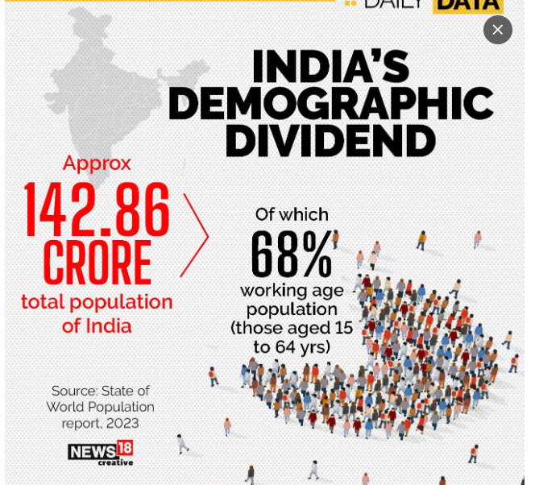

Slide 4
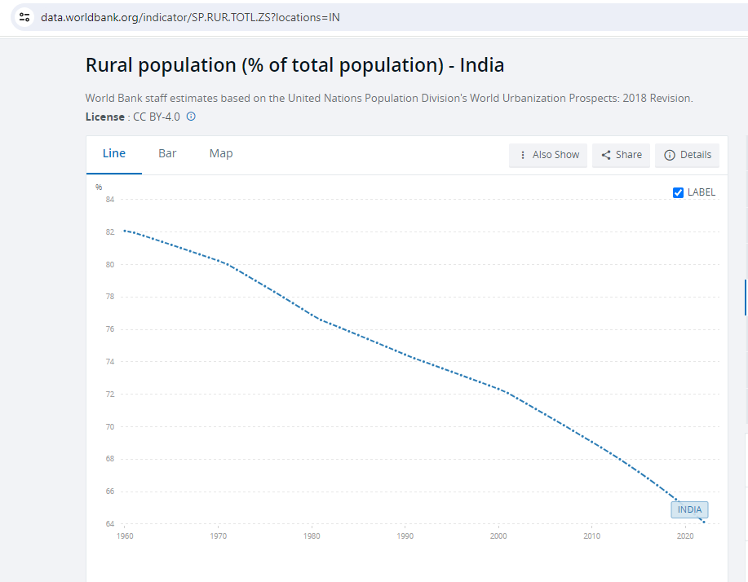

Slide 6
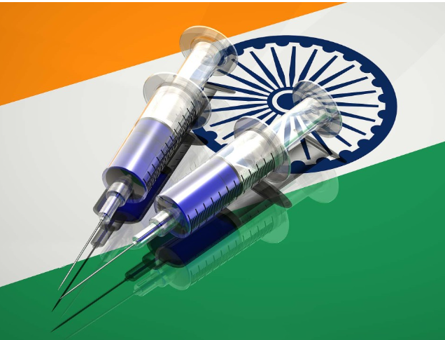

Slide 7
Healthcare Delivery System in India is a diverse and complex sector
Public and private institutions.
Public healthcare system in India is primarily managed and funded by the government
Private healthcare providers, including hospitals, clinics, and diagnostic labs, operate on a profit basis.

Slide 9
According to the Economic Survey 2022, the government expenditure on healthcare was 2.1% of GDP in 2021-22 compared to 1.8% in 2020-21.

Slide 10
HEALTH CARE DELIVERY SYSTEM
It is designed to meet the health needs of the community, through the use of available knowledge and resources.
Two major themes: It should meet the needs of entire population and not merely selected group.
Focus on Primary health care

Slide 11
AIIMS – New Delhi

Slide 12
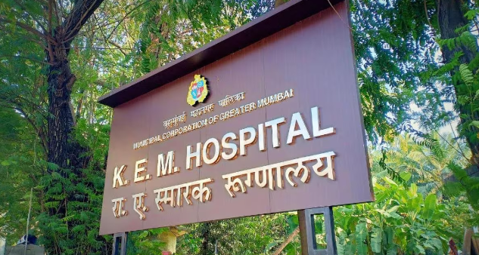
KEM Hospital

Slide 13
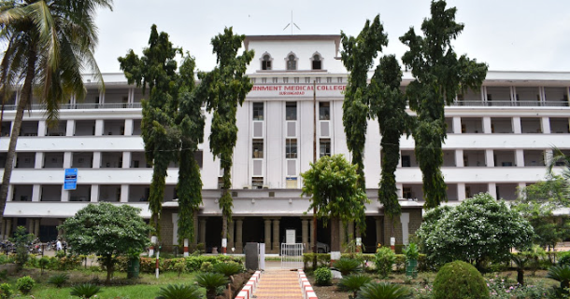
GMC Aurangabad & PHC – Daultabad

Slide 14
Organization of Health Care Delivery System in India
Three Tier System
Central Level
State Level
District Level

Slide 15
Health care delivery system
Implies the organization
Staffing
Regulation
Delivery
Quality Control of the health care services

Slide 16
At the centre
The official “organs” of the health system at the
National level consist of
Ministry of Health and Family Welfare
The Directorate General of Health Services
The Central Council of Health and Family Welfare

Slide 17
Dr. Mansukh Mandaviya
CABINET MINISTER
Ministry of health & family welfare
PROF. S. P. SINGH BAGHEL
MINISTER OF STATE FOR HEALTH AND FAMILY WELFARE
Dr. Bharati Pravin Pawar
Minister of State
Ministry of health & family welfare

Slide 19
Functions of Union Ministry of Health and Family Welfare
Seventh schedule of Article 246 of the constitution of India under
Union list and
Concurrent list
State List

Slide 20
Union list
International health relations and administration of port quarantine.
Administration of Central Institutes such as All India Institute of Hygiene and Public Health, Kolkata.
Promotion of research through research centres
Regulation and development of medical, pharmaceutical, dental, physiotherapy, nursing and allied health professions
Establishment and maintenance of drug standards
Census and collection and publication of other statistical data
Immigration and emigration
Regulation of labour in the working of mines and oil fields
Coordination with states and with other ministries for promotion of health

Slide 21
Concurrent list
Responsibility of both the union and state governments
Prevention and extension of communicable diseases
Prevention of adulteration of food stuffs
Control of drugs and poisons
Vital statistics
Labour welfare
Ports other than major
Economic and social planning
Population control and Family Planning

Slide 22
DGHS

Slide 23
Functions of DGHS
International health relations and quarantine of all major ports in country and international airport
Control of drug standards
Maintain medical store depots
Administration of post graduate training programmes
Administration of certain medical colleges in India
Conducting medical research through Indian Council of Medical Research (ICMR)
Central Government Health Schemes.
Implementation of National Health Programmes
Preparation of health education material for creating health awareness through Central Health Education Bureau.
Collection, compilation, analysis, evaluation and dissemination of information through the Central Bureau of Health Intelligence
National Medical Library

Slide 24
Central Council of Health & Family Welfare

Slide 25
Functions of Central Council
1. To consider and recommend broad outlines of policy with regard to matters concerning health like environment hygiene, nutrition and health education.
2. To make proposals for legislation relating to medical and public health matters.
3. To make recommendations to the Central Government regarding distribution of grants-in-aid.
4. To establish any organization or organizations invested with appropriate functions for promoting and maintaining cooperation between the central and state health administration

Slide 26
State Level
Mr.Tanaji Sawant, Minister for Public Health & FW, Govt of MH

Slide 27
State Level Functions
Formulate health policy.
Set standards for the delivery of health care.
Provide strategic direction for health delivery services.
Allocate resources to all health care delivery agencies under the Ministry.
Provide framework for the development and management of the human resources for health.
Provide a framework for the effective and efficient procurement, distribution, management and use of health sector goods, works and services.
Provide framework for the regulation of food, drugs and health service delivery and practice

Slide 28
Public Health
Family Welfare
Medical Education

Slide 29
ADHO - Additional District Health Office
ADHS - Assistant Director Health services
DHO - District Health Officer
NVBDCP – National Vector Borne Disease Control Program – MDFKJC
DTO - District Tuberculosis Officer
DRCHO - District Reproductive & child Health Officer
DMO - District Malaria Officer
RMO(OR) - Residential Medical Officer (Outreach)
THO - Taluka Health Officer
MS(SDH/RH) - Medical superintend (Sub Divisional Hospital/Rural Hospital)
MPW - Multi Purpose Worker

Slide 30
Tertiary Services in Cities – Govt Medical College Hospitals
OPD
IPD
Angiography
Angioplasty
Dialysis
Chemotherapy
Radiotherapy
Mamography
Nephrology & Urology
Plastic Surgery
Pediatric Surgery
Chest Diseases
Open heart surgeries
Major Surgeries ( Uro/ Onco)
Minor Surgeries
X ray
Sonography
MRI / CT Scan

Slide 31
3) District Level
There are a total of 806 districts in India as on Nov 2023
There are 6 types of administrative areas.
1. Subdivision
2. Tehsils (Taluks)
3. Community Development Blocks
4. Municipalities and Corporations
5. Villages and
6. Panchayats

Slide 32
District (Zilla Parishad)
Sub Division
Sub Collector /
Asst Collector
Sub Divisions
Sub Collector /
Asst Collector
Sub Division
Sub Collector /
Asst Collector
Taluks
Tashildhar
200-600 Villages
Taluks
Tashildhar
200-600 Villages
Taluks
Tashildhar
200-600 Villages
Community Development Blocks
100 Villages – 80k to 120L Population
BDO
Community Development Blocks
100 Villages – 80k to 120L Population
BDO

Slide 33
Community Development Blocks
100 Villages – 80k to 120L Population
BDO
Village Panchyath

Slide 34
Urban areas of the district are organized into
Municipal Boards (in areas with population ranging between 10,000 and 2, 00,000)
Town Area Committees (in areas with population ranging between 5,000 to 10,000)
The Town Area Committees are like panchayats. They provide sanitary services.
Corporations (with population above
2, 00,000)

Slide 35
The functions of Municipal Board
The Municipal Boards are headed by Chairmen / President, elected by members
Construction and maintenance of roads
Sanitation and drainage
Street lighting
Water supply
Maintenance of hospitals and dispensaries
Education and
Registration of births and deaths etc.

Slide 36
Corporations
The Corporations are headed by Mayors, elected by councillors, who are elected from different wards of the city.
The executive agency includes the commissioner, the secretary, the engineer and the health officer.
The activities are similar to those of municipalities, on a much wider scale.

Slide 37
Zilla Parishad
Panchayath Samiti
Panchayath

Slide 38
Secondary Care Services

Slide 39
ASHA workers

Slide 40
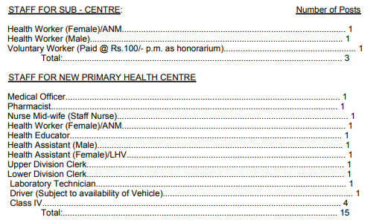

Slide 42
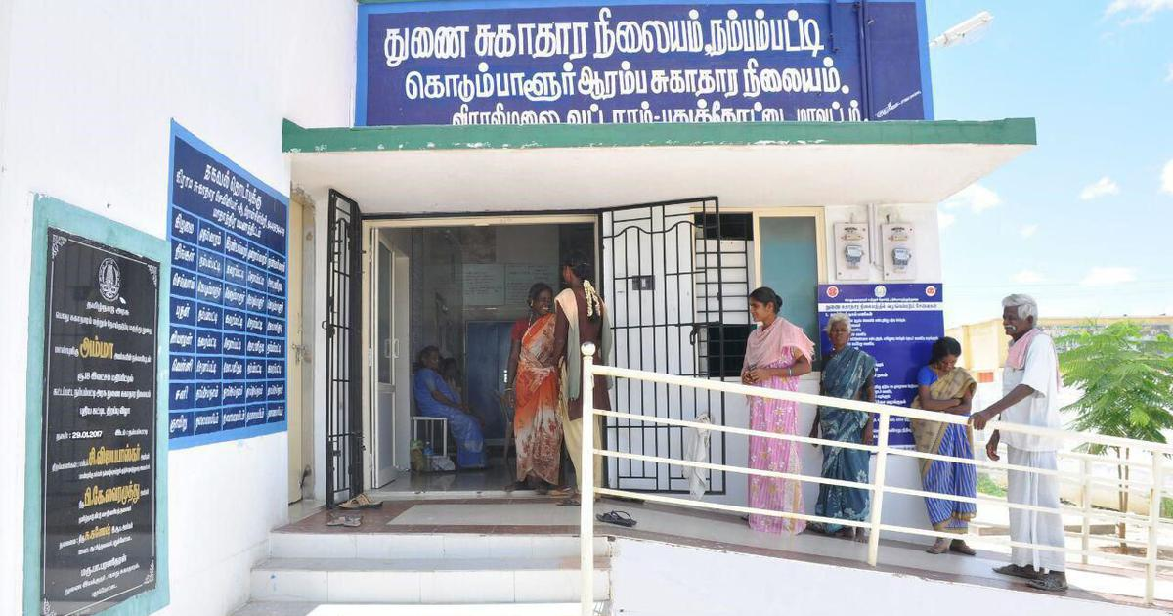
Sub Centre
The Sub-Centre is the most peripheral and first contact point between the primary health care system and the community.
Each Sub-Centre is manned by one Auxiliary Nurse Midwife (ANM) and one Male Health Worker MPW(M)
Sub-Centres are assigned tasks relating to interpersonal communication in order to bring about behavioral change and provide services in relation to maternal and child health, family welfare, nutrition, immunization, diarrhea control and control of communicable diseases programmes.

Slide 43
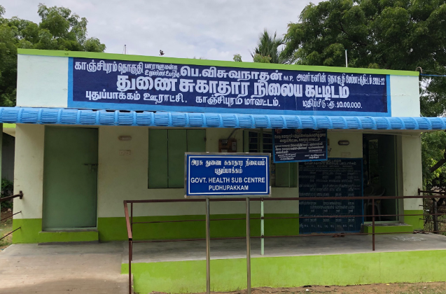
Sub Centre
The Sub-Centres are provided with basic drugs for minor ailments needed for taking care of essential health needs of men, women and children.
The Department of Family Welfare is providing 100% Central assistance to all the Sub-Centres in the country in the form of salary of ANMs and LHVs, rent at the rate of Rs. 3000/- per annum and contingency at the rate of Rs. 3200/- per annum, in addition to drugs and equipment kits.
The salary of the Male Worker is borne by the State Governments.

Slide 44
PHC is the first contact point between village community and the Medical Officer.
The PHCs were envisaged to provide an integrated curative and preventive health care to the rural population with emphasis on preventive and promotive aspects of health care.

Slide 45
The PHCs are established and maintained by the State Governments under the Minimum Needs Programme (MNP)/ Basic Minimum Services Programme (BMS).
At present, a PHC is manned by a Medical Officer supported by 14 paramedical and other staff.
It acts as a referral unit for 6 Sub Centres. It has 4 - 6 beds for patients.
The activities of PHC involve curative, preventive, primitive and Family Welfare Services.

Slide 46
NHM
National Rural Health Mission (NRHM) was launched by the Hon’ble Prime Minister on 12th April 2005
The Union Cabinet vide its decision dated 1st May 2013, has approved the launch of National Urban Health Mission (NUHM) as a Sub-mission of an over-arching National Health Mission (NHM)

Slide 47
KEY FEATURES
Making the public health delivery system fully functional and accountable to the community,
human resources management,
community involvement,
decentralization,
rigorous monitoring & evaluation against standards,
the convergence of health and related programmes from village level upwards,
innovations and flexible financing and
also interventions for improving the health indicators.

Slide 48
NHM – NRHM & NUHM
Reproductive-Maternal- Neonatal-Child and Adolescent Health (RMNCH+A)

Slide 49
National Health Policy, 2017 recommended strengthening the delivery of primary health care, through establishment of "Health and Wellness Centres"
Universal Health Coverage

Slide 50
Ayushman Bharat or "Healthy India" national initiative was launched as recommended by the National Health Policy 2017, to achieve the vision of Universal Health Coverage (UHC).
This initiative has been designed on the lines as to meet SDG and its underlining commitment, which is "leave no one behind".

Slide 51
Ayushman Bharat - comprising of two inter-related components, which are -
Establishment of Health and Wellness Centres
Pradhan Mantri Jan Arogya Yojana (PM-JAY)

Slide 52
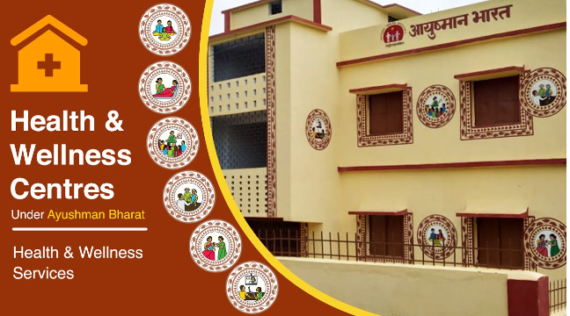
Health and Wellness Centres
In February 2018, the Government of India's announced the creation of 1,50,000 Health and Wellness Centres (HWCs)
Transforming existing Sub Centres and Primary Health Centres as the base pillar of Ayushman Bharat.
These centres would deliver Comprehensive Primary Health Care (CPHC) bringing healthcare closer to the homes of people covering both maternal and child health services and non-communicable diseases, including free essential drugs and diagnostic services.

Slide 53
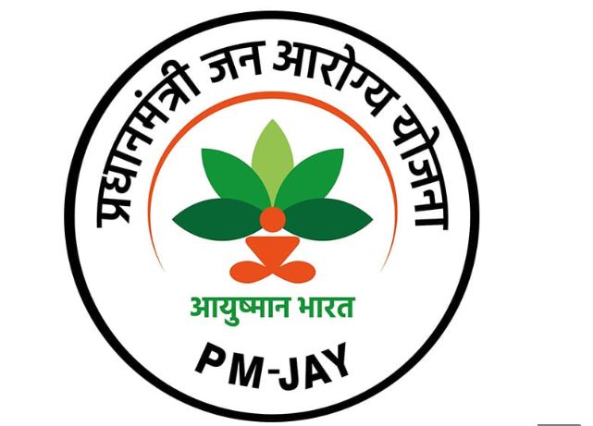
Pradhan Mantri Jan Arogya Yojana (PM-JAY)
The other component of Ayushman Bharat, namely Pradhan Mantri Jan Arogya Yojana (PMJAY) aims to provide financial protection for secondary and tertiary care to about 40% of India's households.
Together the two components of Ayushman Bharat will enable the realization of the aspiration of Universal Health Coverage

Slide 55
At the district level
Most district in India are divided into two or more subdivision, each incharge of an Assistant Collector or Sub Collector –
(Chhatrapati Sambhajinagar, Sillod, Vaijapur,Paithan-Phulmbri &
Kannad)
Each division is again divided into taluks, in charge of a Thasildhar. A taluk usually comprises between 200 to 600villages.
The community development block comprises approximately 100 villages and about 80000 to 1, 20,000 population, in charge of a Block Development Officer.
Finally, there are the village panchayats, which are institutions of rural local self-government.

